Slide 1
Pest Management

Slide 2
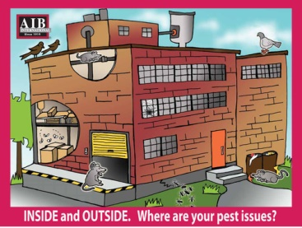
Inside and Outside
Inside and Outside. What are your pest issues?

Slide 3
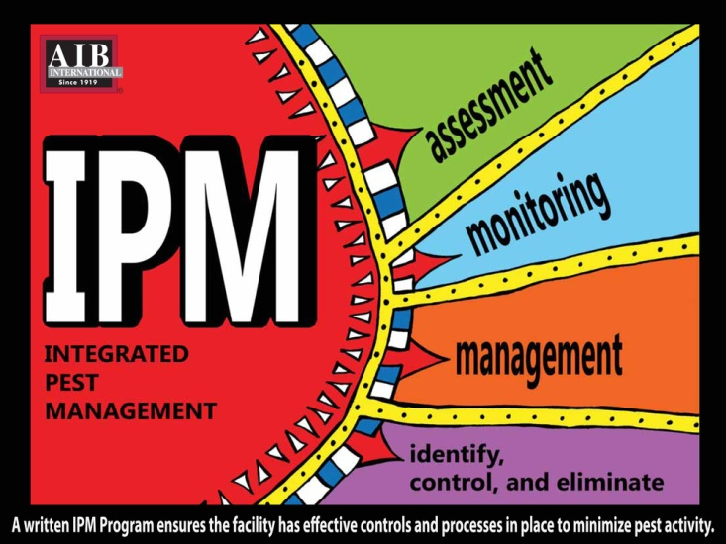
Integrated Pest Management
Notes:
A proper Integrated Pest Management plant consists of assessments, monitoring, management, and Identify, control and eliminate.

Slide 4
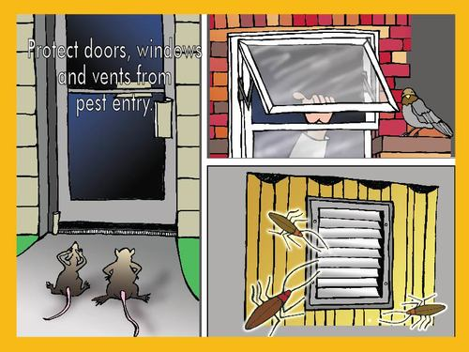
Keep Pests Out
Protect doors, windows and vents from pest entry.

Slide 5
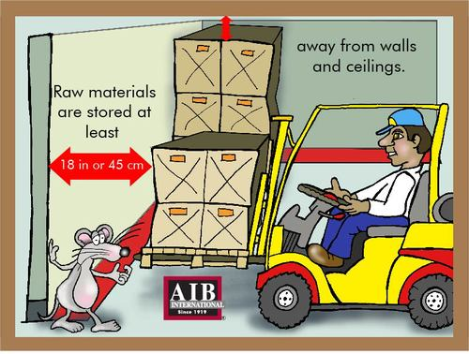
Raw Materials
Raw materials are stored at least 18 inches or 45 centimeters away from walls and ceilings.

Slide 6
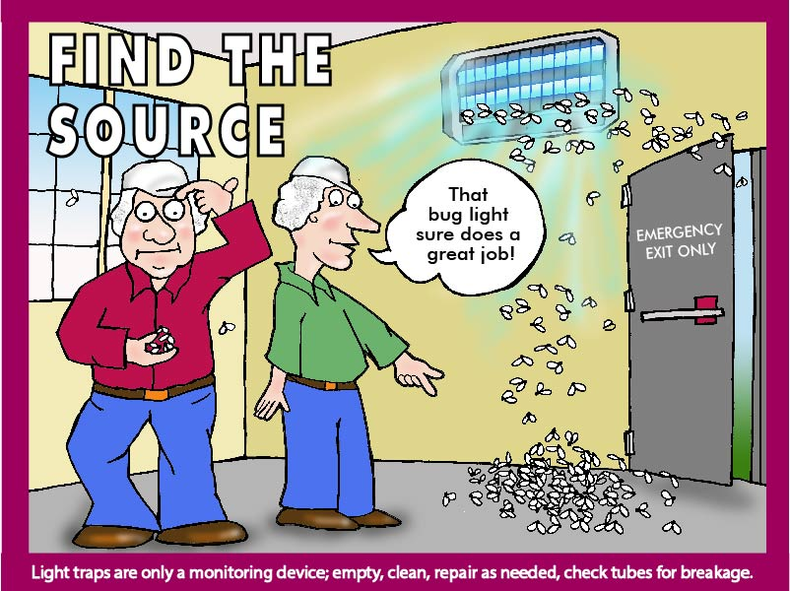
Find the Source
Light traps are only a monitoring device. Empty, clean, repair as needed, and check tubes for breakage.

Slide 7
Signed Contracts
Does the plant and the contractor understand the expectation?

Slide 8
Exterior Rodent Monitoring Devices
Place along foundation walls. Inspect monthly. Locked and tamper resistant. Bait is secured and in a good condition. Bait is replaced as needed.

Slide 9
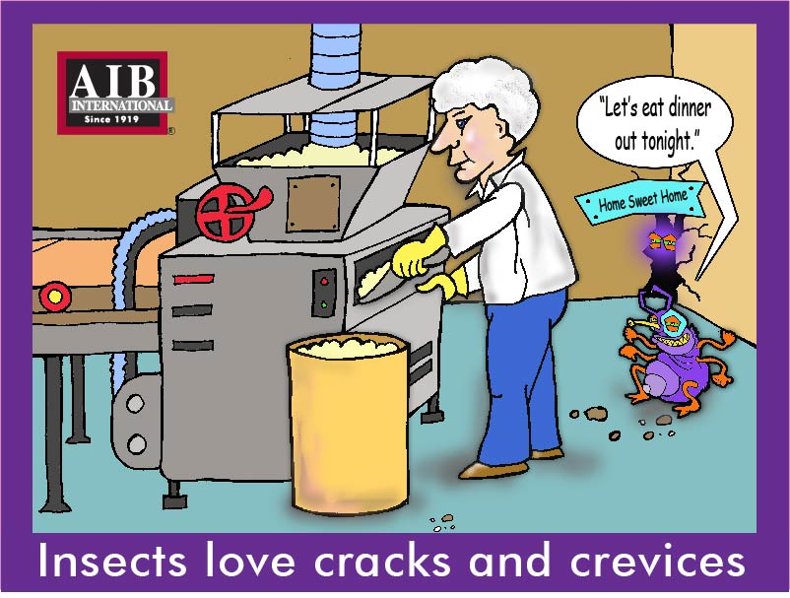
Insects
Insects love cracks and crevices.

Slide 10
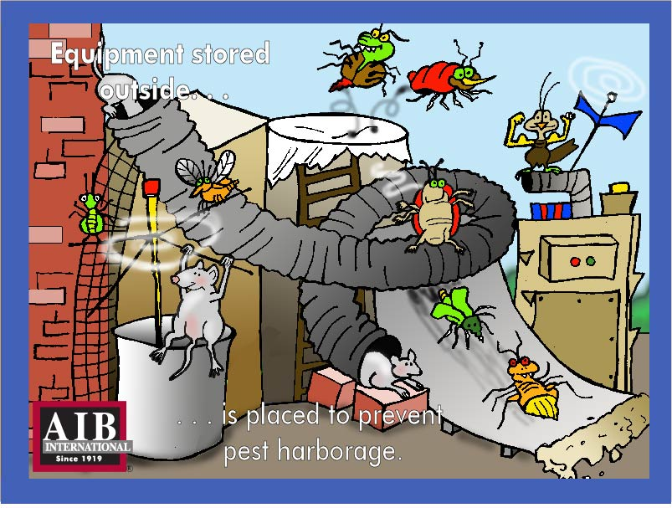
Equipment Stored Outside
Equipment stored outside should be placed to prevent pest harborage.

Slide 11
Knowledge is the Key to Success
Every issue has a story to tell. Just listen and learn

Slide 12
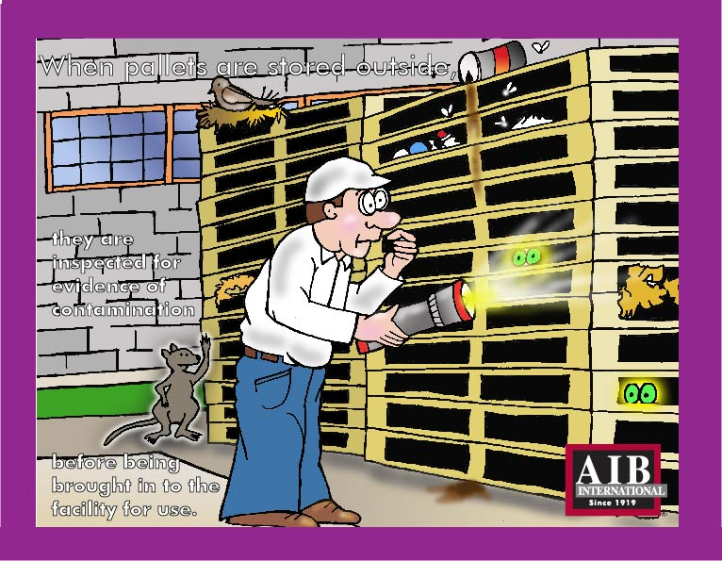
Outside Pallet Storage
When pallets are sorted outside, they are inspected for evidence of contamination before being brought into the facility for use.

Slide 13
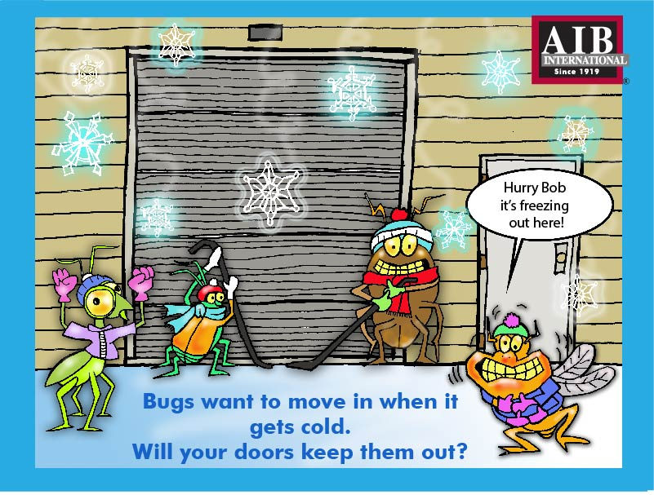
Keep Bugs Out
Bugs want to move in when it gets cold. Will your doors keep them out

Slide 14
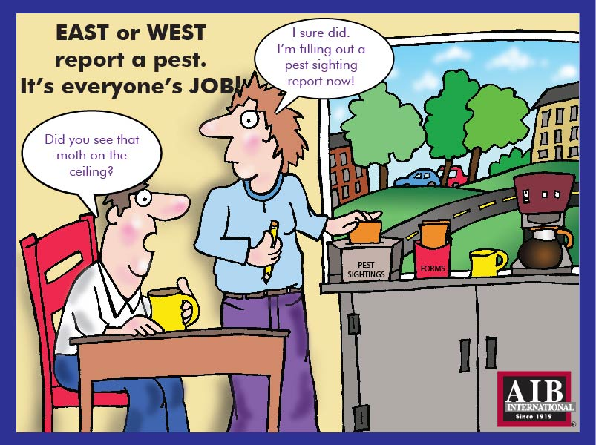
Report a Pest
East or West report a pest. It's everyone's job!

Slide 15
Vending Machines
Are your vending machines on your Master Cleaning Schedule? They can be easily overlooked and are a good harborage for pests.

